Slide 1
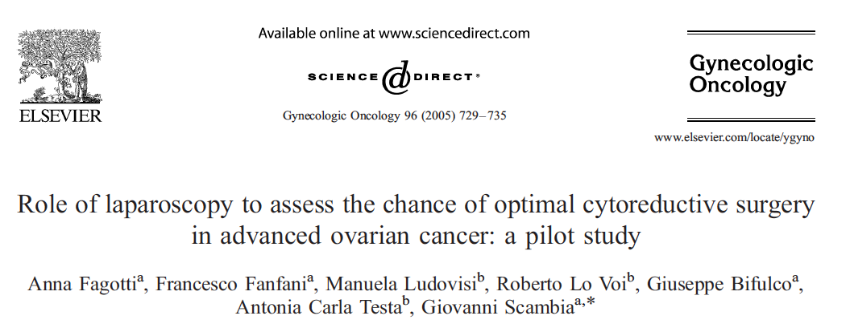


Notes:
In 2005, Anna Fagotti and her group embarked on a long and productive journey on the study of laparoscopy as a tool to assess feasibility of optimal cytoreductive surgery.
In that initial publication, the authors published the results of a pilot study of 64 patients with advanced ovarian or peritoneal cancer who underwent laparoscopy and subsequent laparotomy to assess optimal cytoreduction.

Slide 2
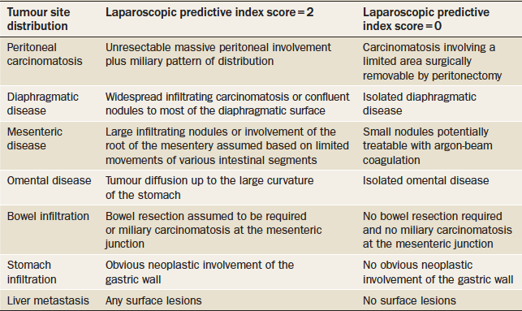

Slide 4
